Slide 1
Precession Diffraction: The Philospher’s Stone of Electron Crystallography?

Slide 2
Focus
Many methods exist for obtaining diffraction information
  Selected Area
  Nanodiffraction and variants
  CBED
All are complicated to interpret
Reciprocal space is right, but intensities depend upon thickness, tilt etc

Slide 3
What PED can do
We would like a method where not just the positions of the spots, but also the intensities could be used.
Not rigorously equivalent to simple kinematical diffraction, but has many similarities
  If the structure factor is large → Intensity is large
  Useful for fingerprinting structures
  Often does not need calculations to interpret

Slide 4
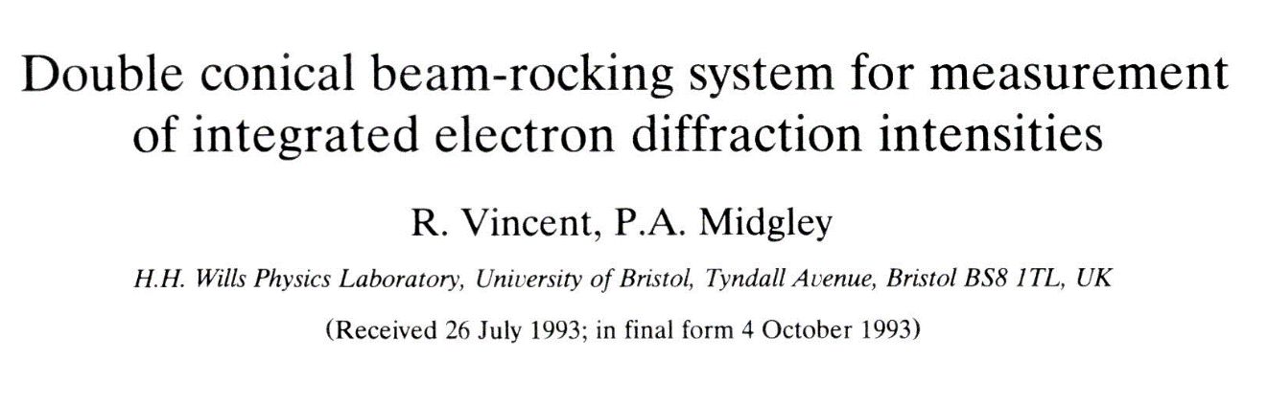
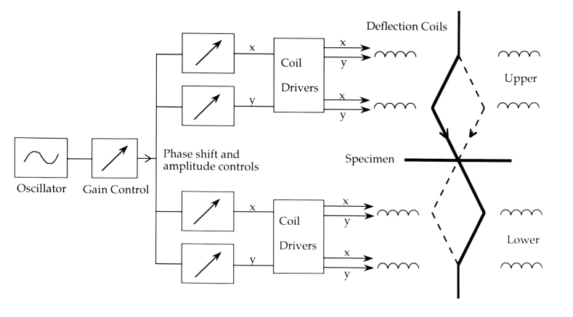
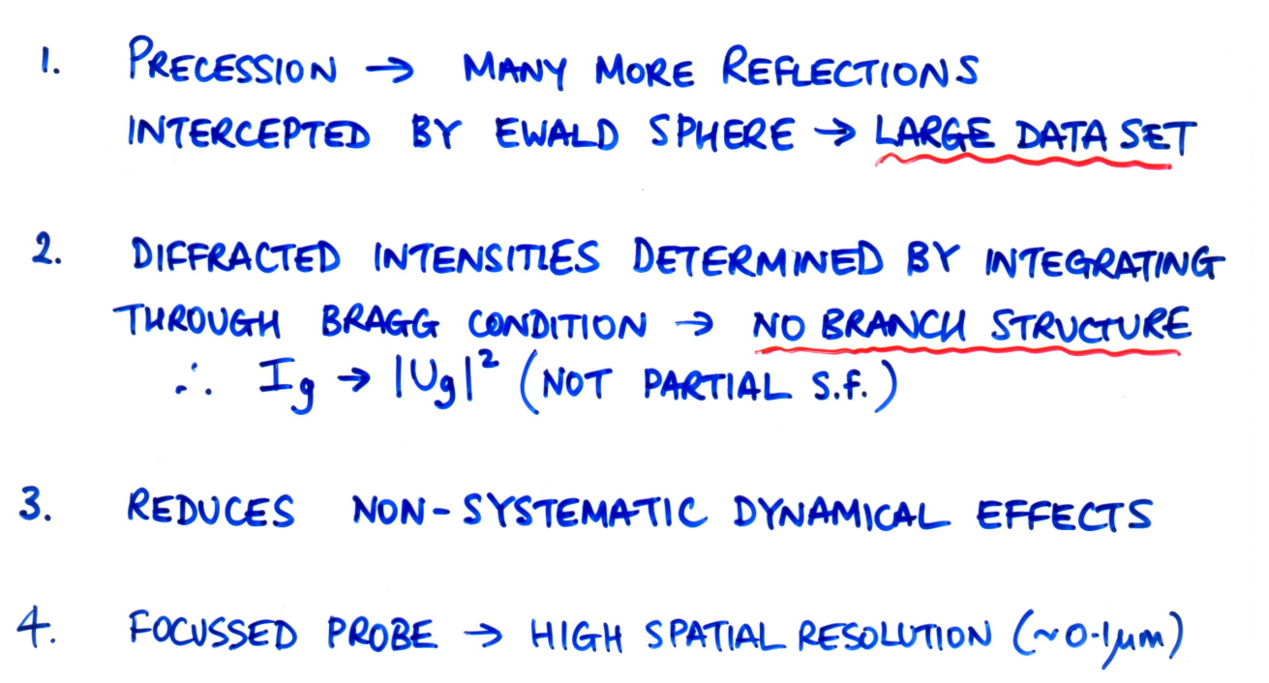
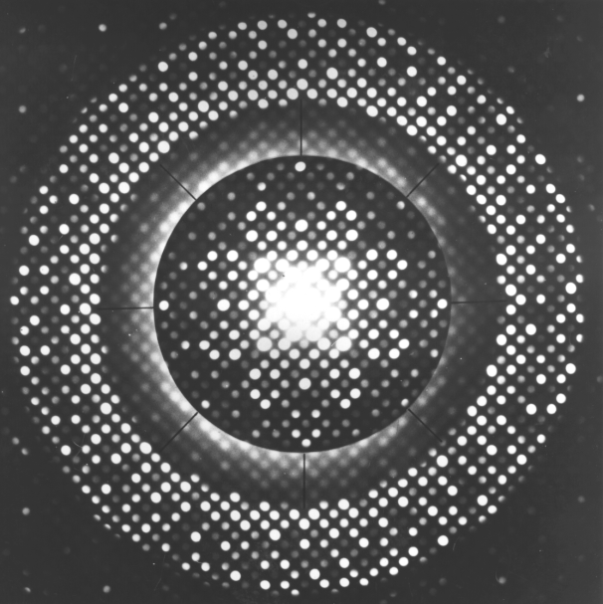
History – Electron Precession (1993)
Advantages:
e⁻
e⁻
μ
μ

Slide 5
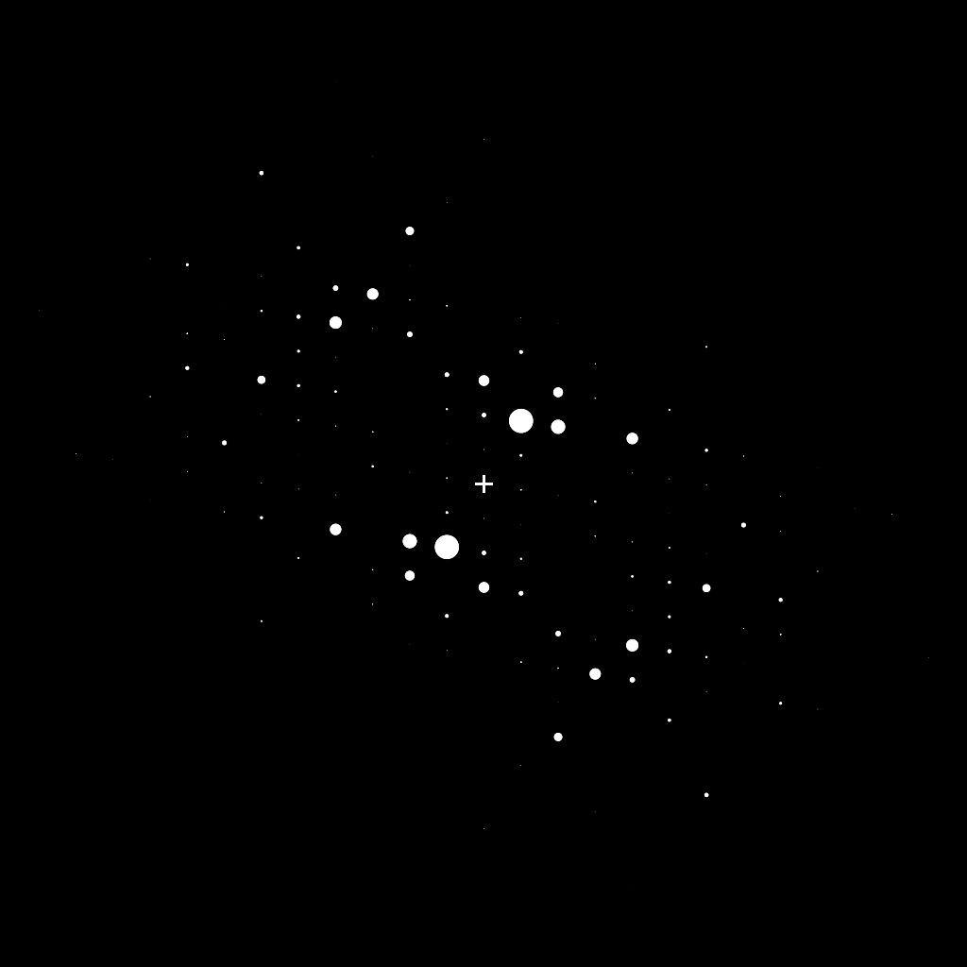
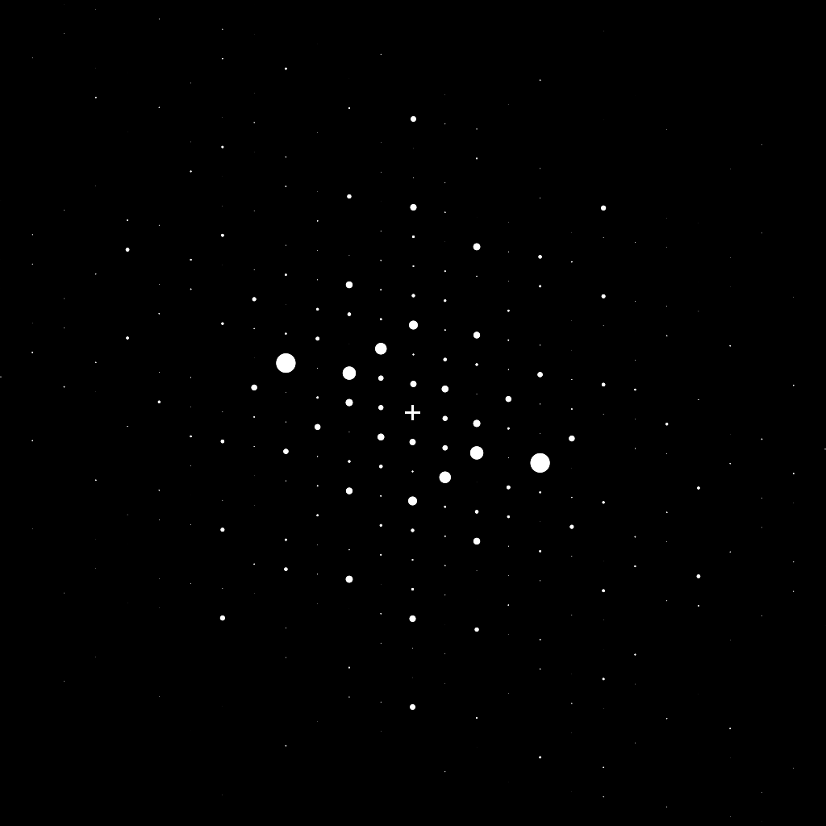
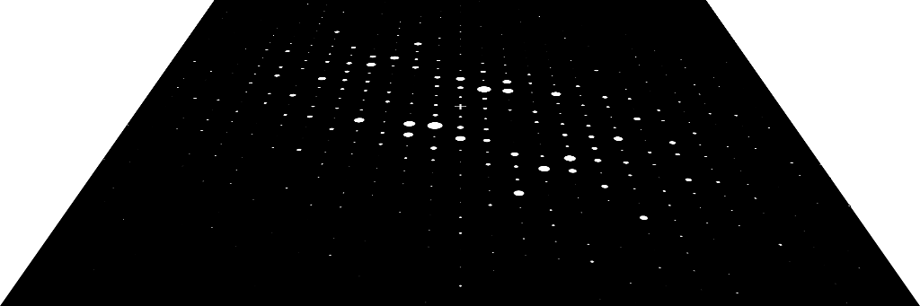



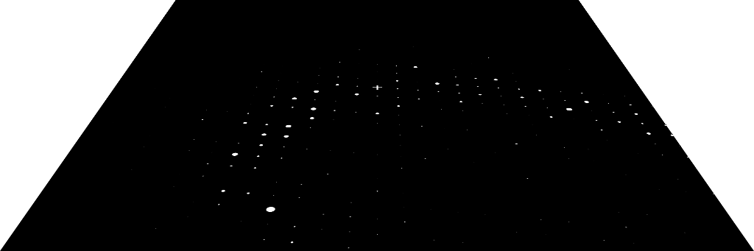
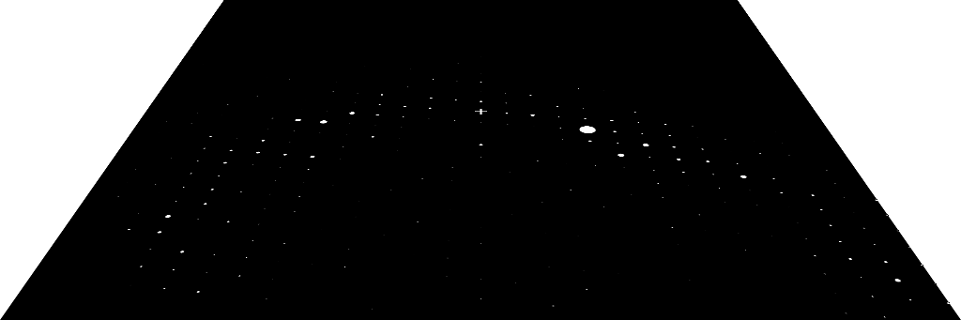
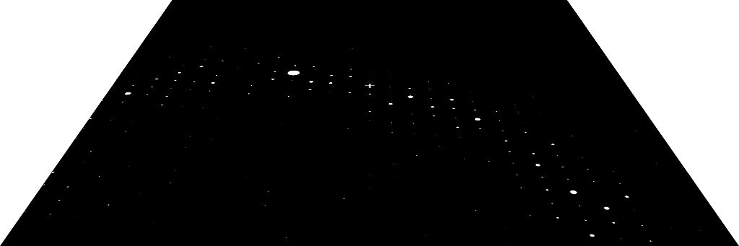




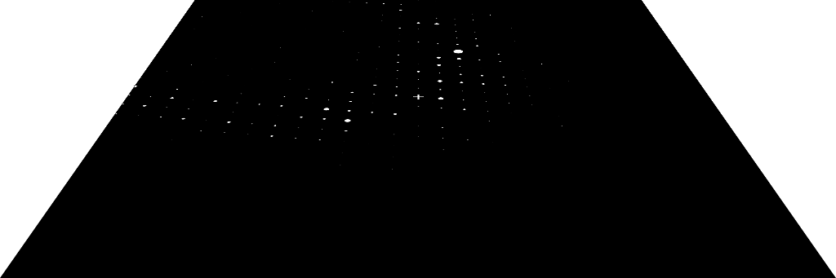


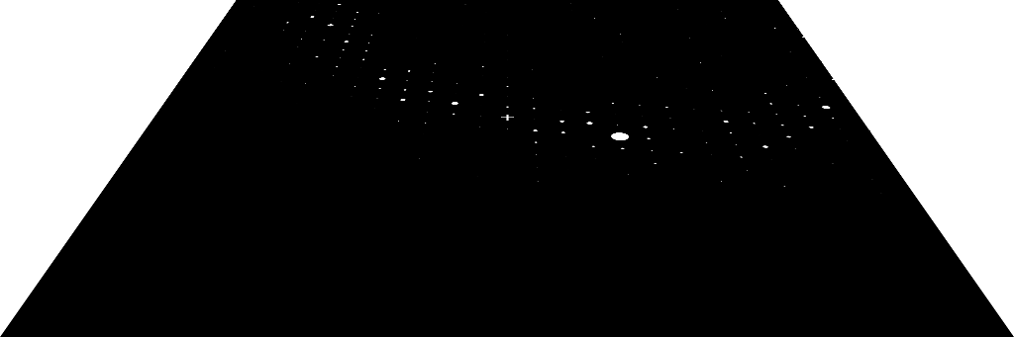


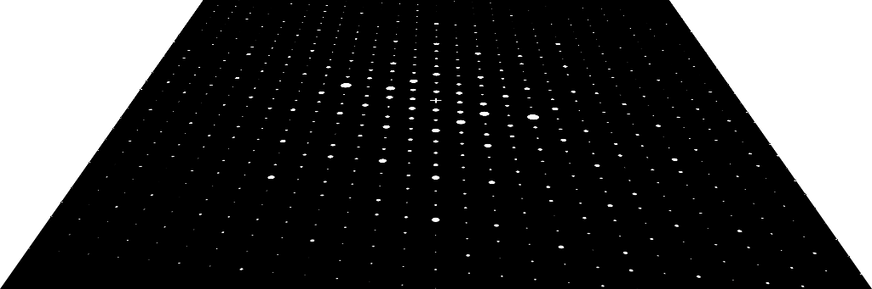
Scan
Specimen
Non-precessed
Precessed
De-scan
(Ga,In)₂SnO₅ Intensities
412Å crystal thickness
Conventional Diffraction Pattern
Precession Diffraction Pattern
Precession…
(Diffracted amplitudes)

Slide 6
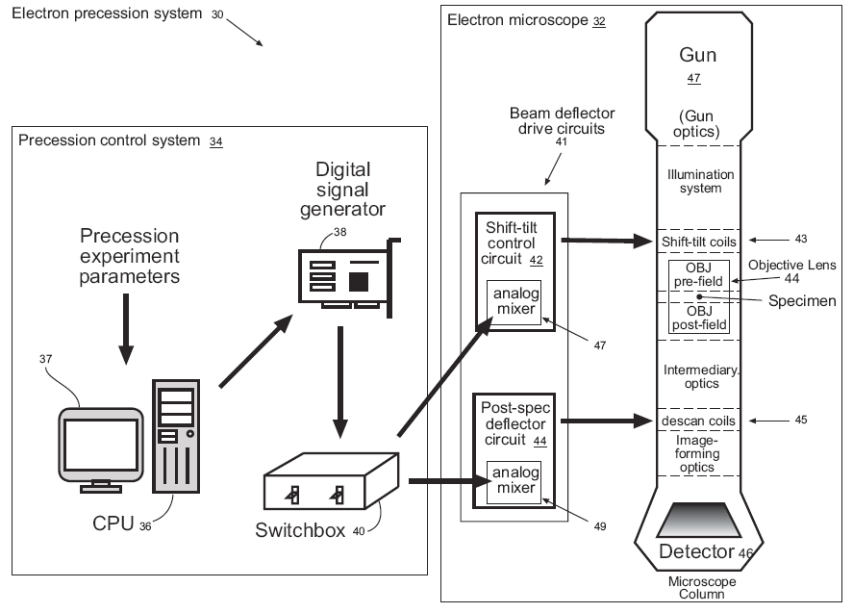
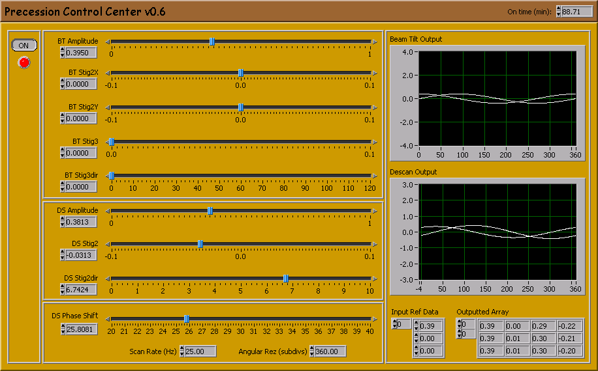
Precession
System
US patent application:
“A hollow-cone electron diffraction system”.
Application serial number 60/531,641, Dec 2004.

Slide 7
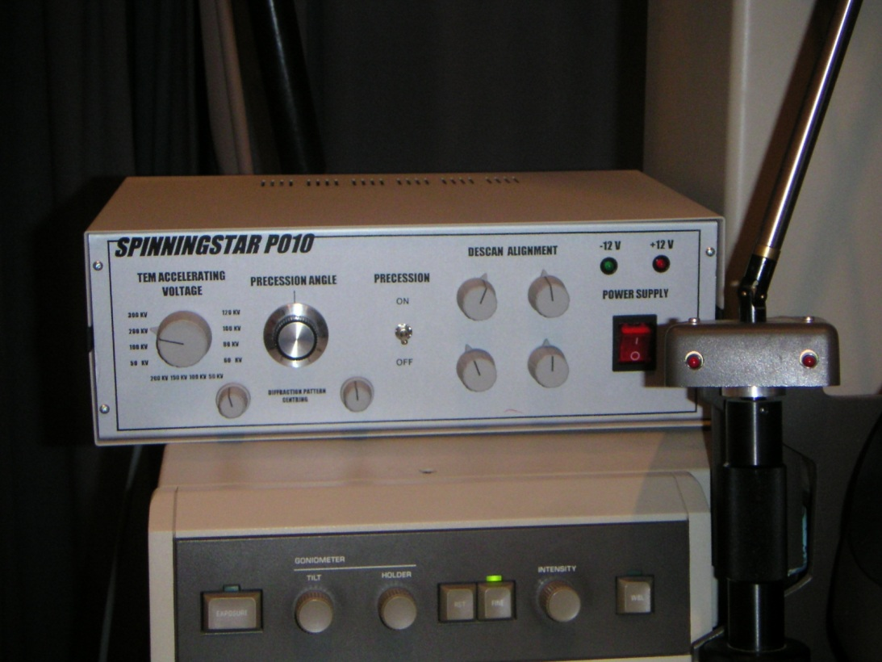

SPINNING STAR : UNIVERSAL INTERFASE FOR PRECESSION ELECTRON DIFFRACTION FOR ANY TEM ( 120 -200 -300 KV )
Can be easily retrofitable to any TEM 100- 300 KV
precession is possible for any beam size 300 - 50 nm
Precession is possible for a parallel or convergent beam
precession eliminates false spots to ED pattern that belong to dynamical contributions
precession angle can vary continuously (0°-3°) to observe true crystallographic symmetry variation
Software ELD for easy quantification of ED intensities and automatic symmetry ( point, space group ) research
Easily interfaced to electron diffractometer for automatic 3D structure determination

Slide 8
Examples:
Complicated Structures
  Hard to interpret SAED
  Simple to interpret PED
EDS
  Elemental ratio’s depend upon orientation in standard mode
  Weak to no dependence with PED

Slide 9
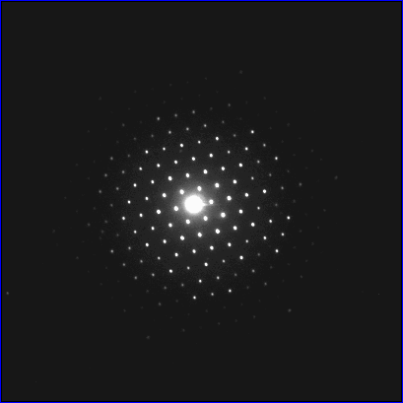
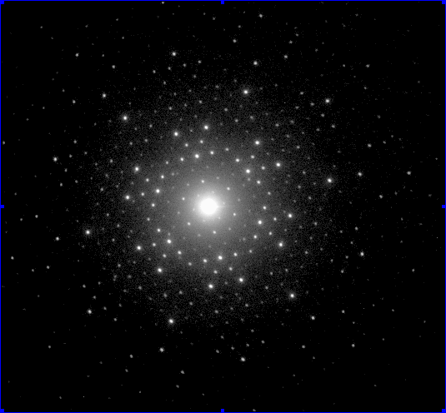
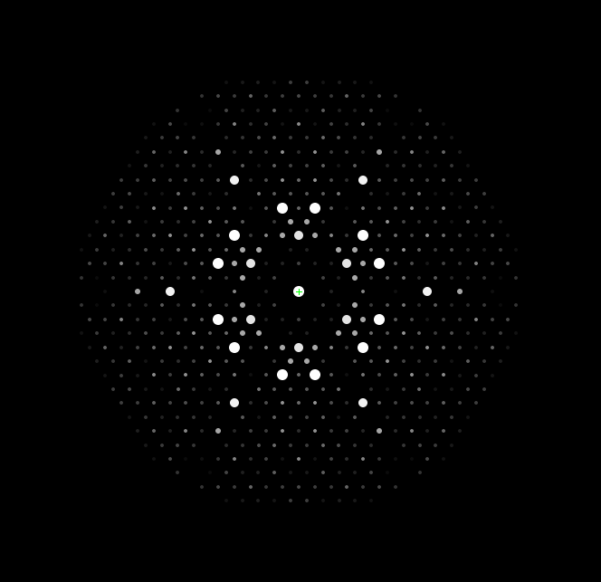
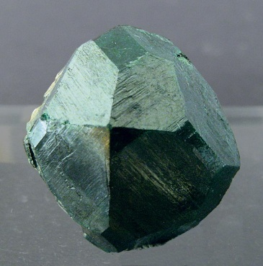
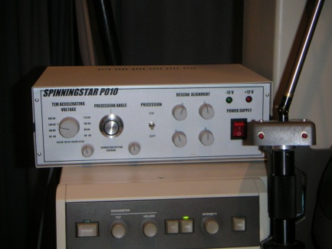
APPLICATION : FIND TRUE CRYSTAL SYMMETRY
PRECESSION OFF
PRECESSION ON
IDEAL KINEMATICAL (111)
UVAROVITE (111)
Courtesy M.Gemmi
Univ of Milano

Slide 10
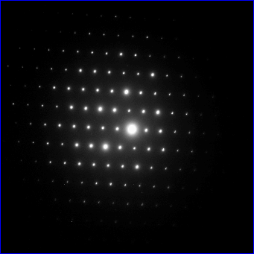
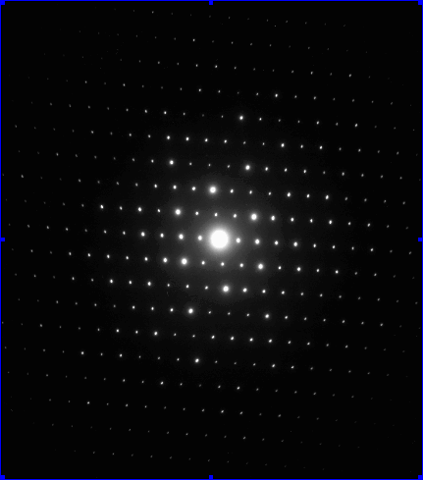
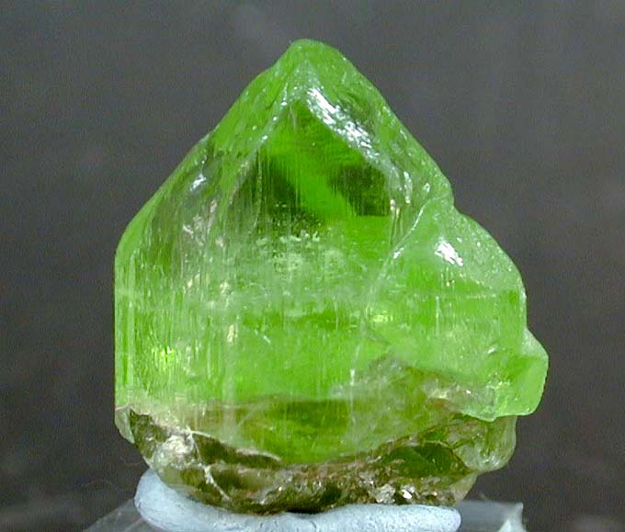

APPLICATION : PERFECT CRYSTAL ORIENTATION
PRECESSION ON
OLIVINE
PRECESSION OFF
Crystals –specially minerals -usually grow in platelet
or fiber shape and results dificult to orient perfectly in a particular zone axis; in this example olivine crystals are perfectly oriented after precession is on.
Courtesy X.Zou, S.Hovmoller Univ Stockholm

Slide 11
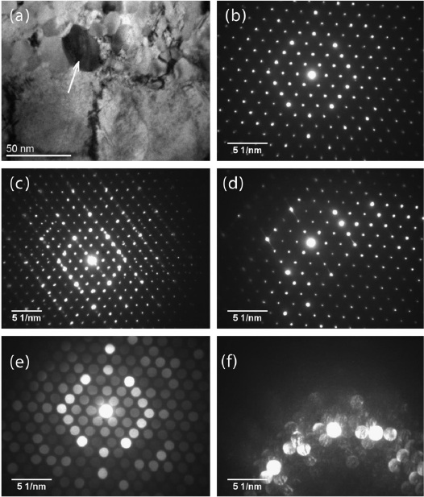
Carbide

Slide 12
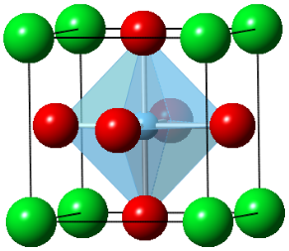
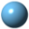


Crystal Structures of STO and Fe₂MnAl
Ti
Fe
O
Mn
Sr
Al
STO (Perovskite)
Fe₂MnAl (L2₁-ordered)
Notes:
Ordered oxide and intermetallics.

Slide 13
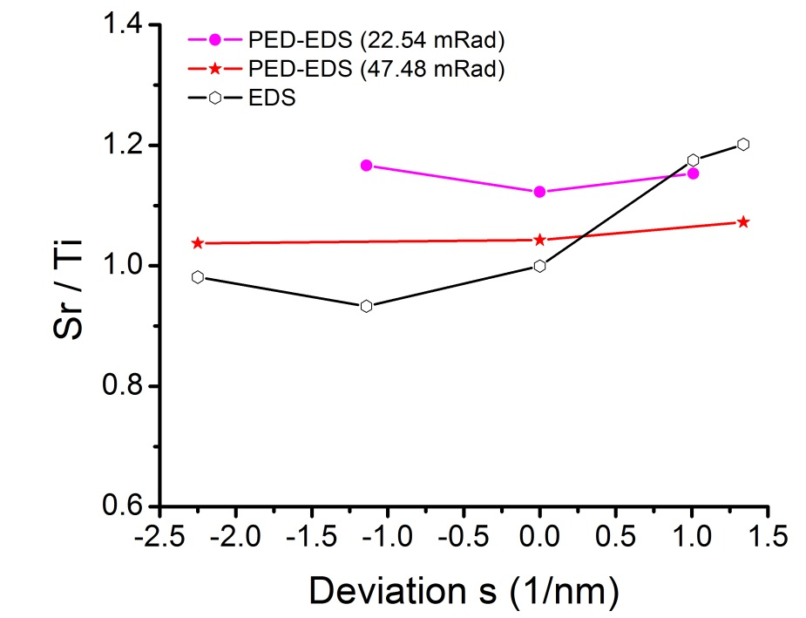
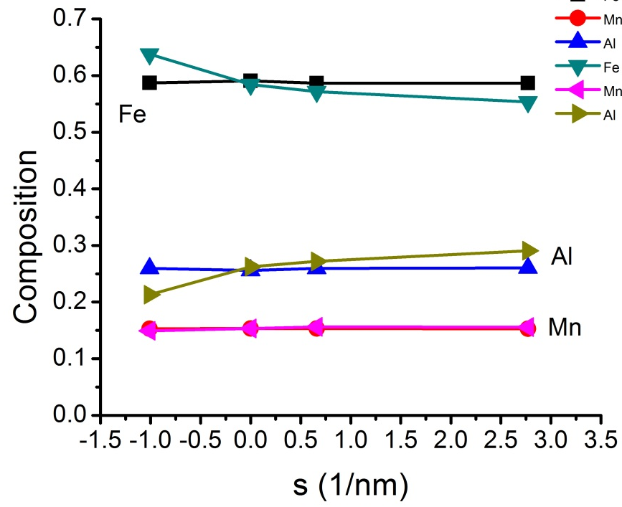
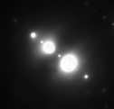
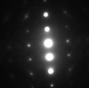
PED-EDS in ALCHEMI Type Measurements
Fe₂MnAl
SrTiO₃
Reduced electron channeling effects (g=200 for both cases)
Orientation-insensitive chemistry measurement
Liao and Marks, Ultramicroscopy, 126, 2013
Notes:
Channeling obtained by setting a standing electron wave across the structure. Alchemi is first proposal by Tafto and Spence, 218, Science, 1982; Tafto and Spence, 9, Ultramicroscopy, 1982.

Slide 14
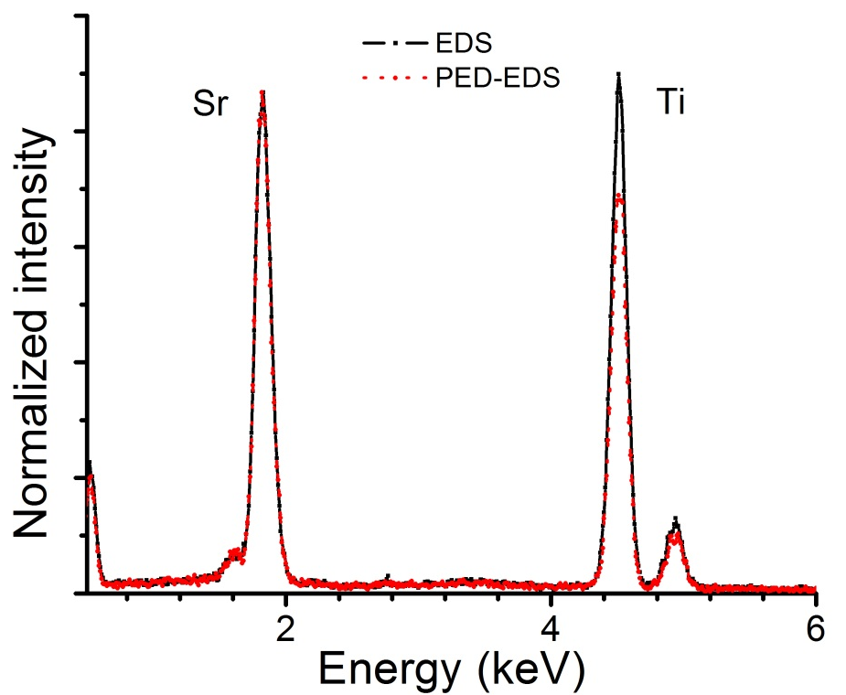
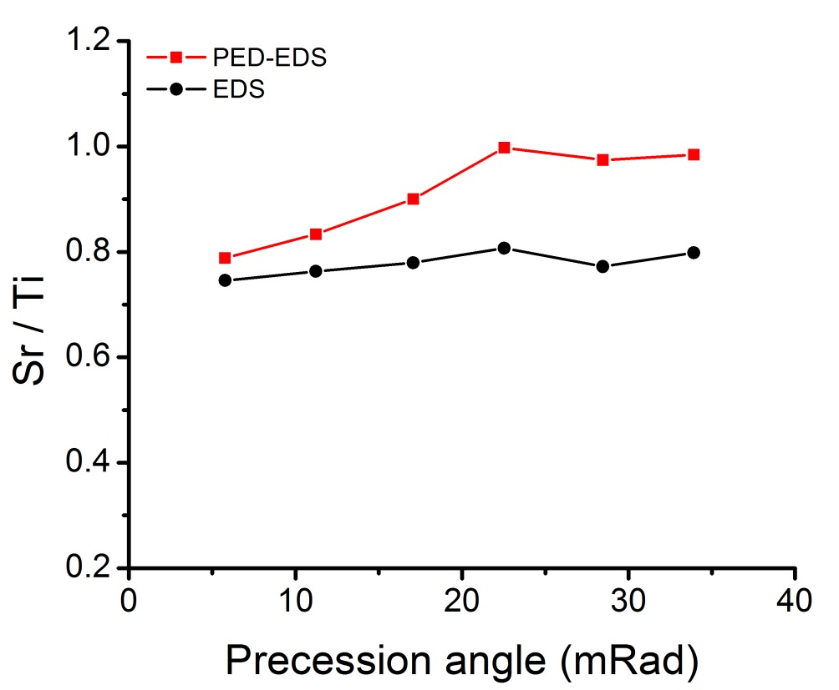
Effects of Precession Angle
Sr/Ti increases with increasing precession angle when θ <23 mrad.
Sr/Ti is ~1 when θ > 23 mrad.
Liao and Marks, Ultramicroscopy, 126, 2013
Notes:
higher angle results in less dynamical effects. It depends on material species, orientation and presumably thickness.

Slide 15
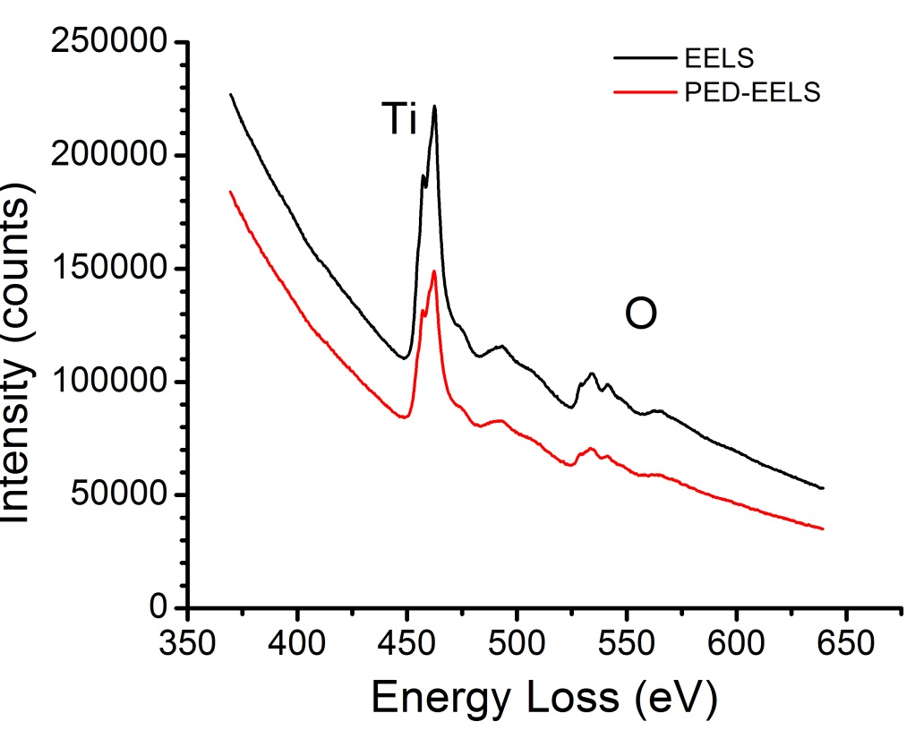
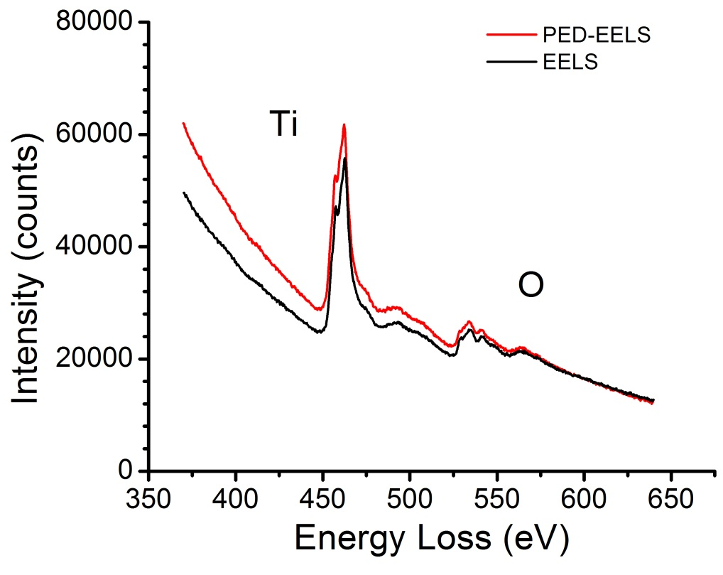
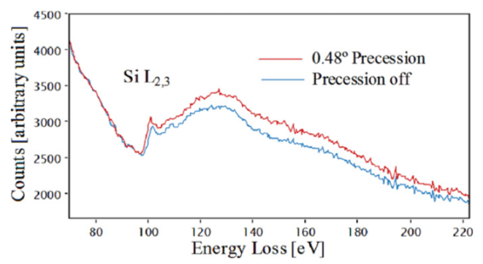
PED-EELS ?
Two-beam
Zone-axis
Estrade et al., Ultramicroscopy, 2012
Signal is enhanced for zone-axis PED-EELS
Signal is reduced for two-beam PED-EELS
In both cases, Ti/O ratio is unchanged

Slide 16
Practical Use
Two commercial systems (one hardware, another software) are available
Not complicated, and could probably be written in scripting language
Alignment can be tricky – it always is
Not rocket science, to use

Slide 17
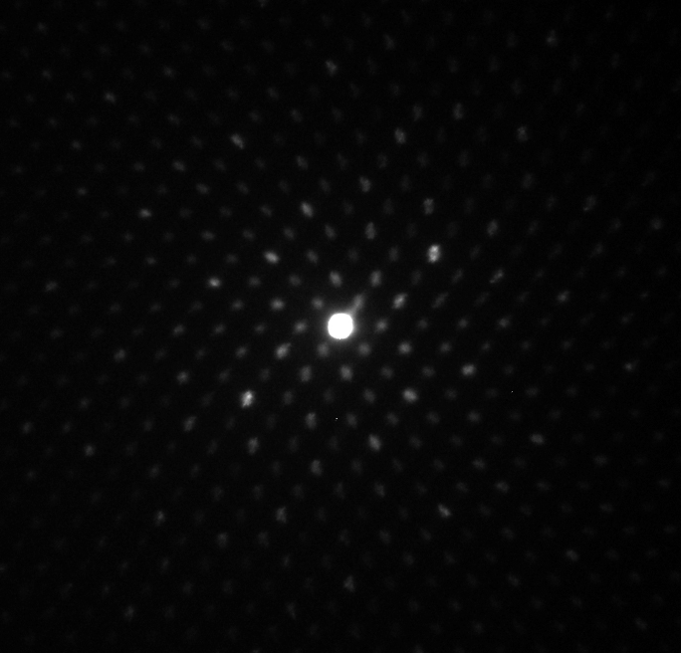
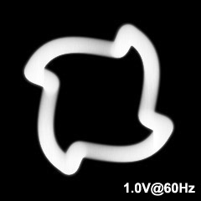
Some Practical Issues
Projector Spiral Distortions (60 mRad tilt)
Bi-polar push-pull circuit (H9000)

Slide 18

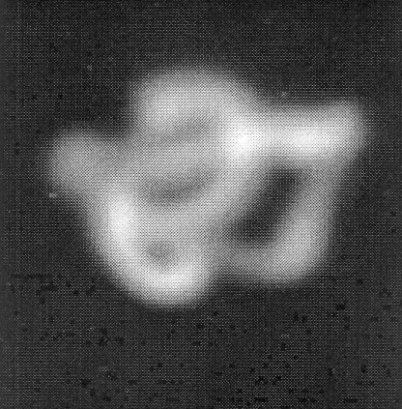
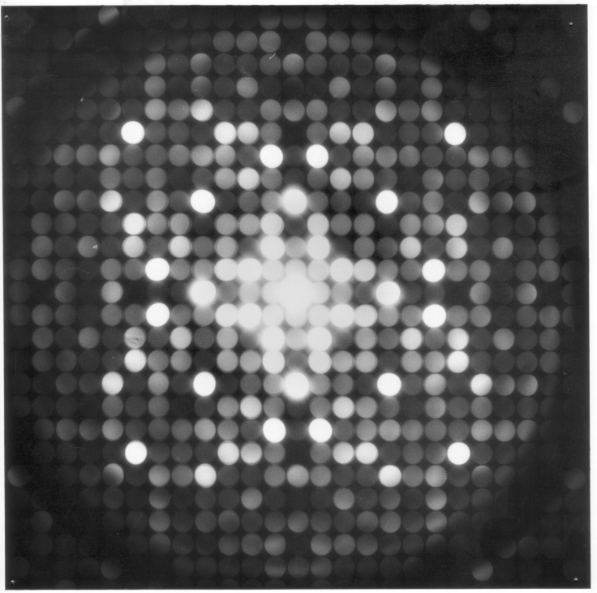
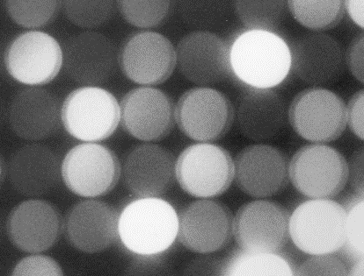

Block Diagram
‘Aberrations’
e⁻
e⁻
μ
μ

Slide 19
Remember the optics
Idealized Diagram
Better Diagram
Postfield Misaligned
Scan
Objective Prefield
Sample
Objective Postfield
Descan

Slide 20
Remember the optics
Idealized Diagram
Correct Diagram
Both Misaligned
Scan
Objective Prefield
Sample
Objective Postfield
Descan

Slide 21
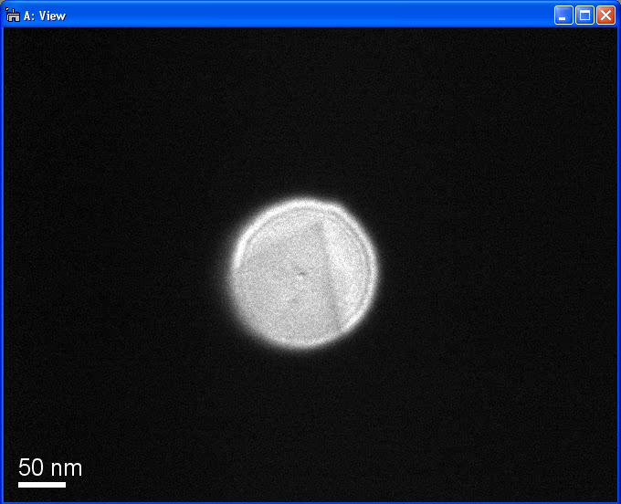
Alignment can be tricky

Slide 22
Why?
Although PED has been around since 1992, and very actively used for ~10 years (mainly in Europe), there is no simple explanation (many have tried and failed)
Explanation is a bit rocket science

Slide 23
Why?
What, if any generalizations can be made?
Role of Precession Angle
  Systematic Row Limit
Importance of integration
  Phase insensitivity
  Important for which reflections are used
  Fast Integration Options

Slide 24
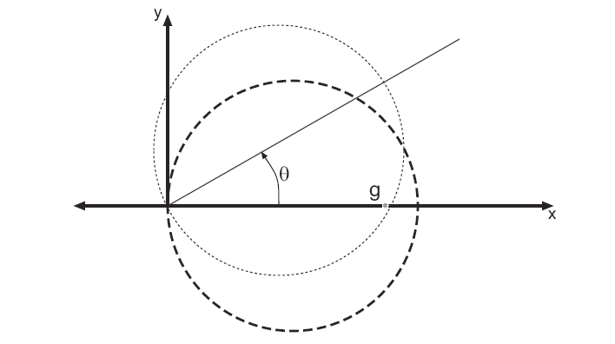
Ewald Sphere
Construction
Scan
Specimen
k+s
De-scan
k
s
s_{z}
(Diffracted amplitudes)
g
^{z}
0

Slide 25
Levels of theory
Precession integrates each beam over s_{z}
Full dynamical theory
  All reciprocal lattice vectors are coupled and not seperable
Partial dynamical theory (2-beam)
  Consider each reciprocal lattice vector dynamically coupled to transmitted beam only
Kinematical theory
  Consider only role of s_{z} assuming weak scattering
Bragg’s Law
  I = |F(g)|²

Slide 26
Early Models
I_{obs} depends upon |F(g)|, g, φ (precession angle) which we “correct” to the true result
Options:
0) No correction at all, I=|F(g)|²
1) Geometry only (Lorentz, by analogy to x-ray diffraction) corresponds to angular integration
2) Geometry plus multiplicative term for |F(g)|

Slide 27
Bragg’s Law fails badly (Ga,In)₂SnO₅
3.2 Å; R=0.02
50 Å; R=0.19
100 Å; R=0.25
200 Å; R=0.49
400 Å*; R=0.78
800 Å; R=0.88

Slide 28
Kinematical Lorentz Correction
I(g) =∫ |F(g) sin(πts_{z})/(πs_{z}) |² ds_{z}
s_{z} taken appropriately over the Precession Circuit
t is crystal thickness (column approximation)
φ is total precession angle
I(g) = |F(g)|²L(g,t,φ)
K. Gjønnes, Ultramicroscopy, 1997.

Slide 29
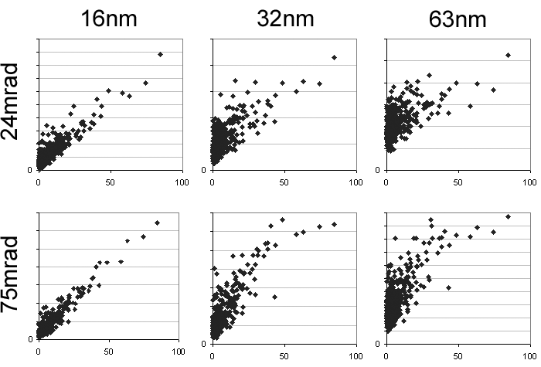
Kinematical Lorentz correction:
Geometry information is insufficient
F_{corr}
F_{kin}
Need structure factors to apply the correction!

Slide 30
2-Beam (Blackman) form
Limits:
  A_{g} small; I_{dyn}(k) ∝ I_{kin}(k)
  A_{g} large; I_{dyn}(k) ∝ √I_{kin}(k) = |F_{kin}(k)|
But…
This assumes integration over all angles, which is not correct for precession (correct for powder diffraction)

Slide 31
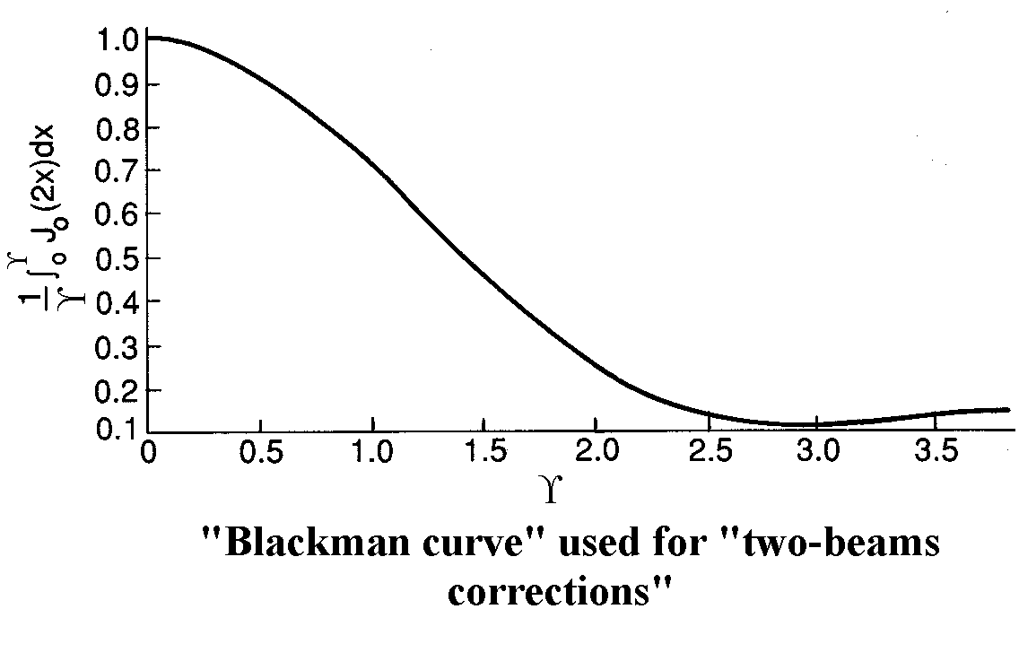
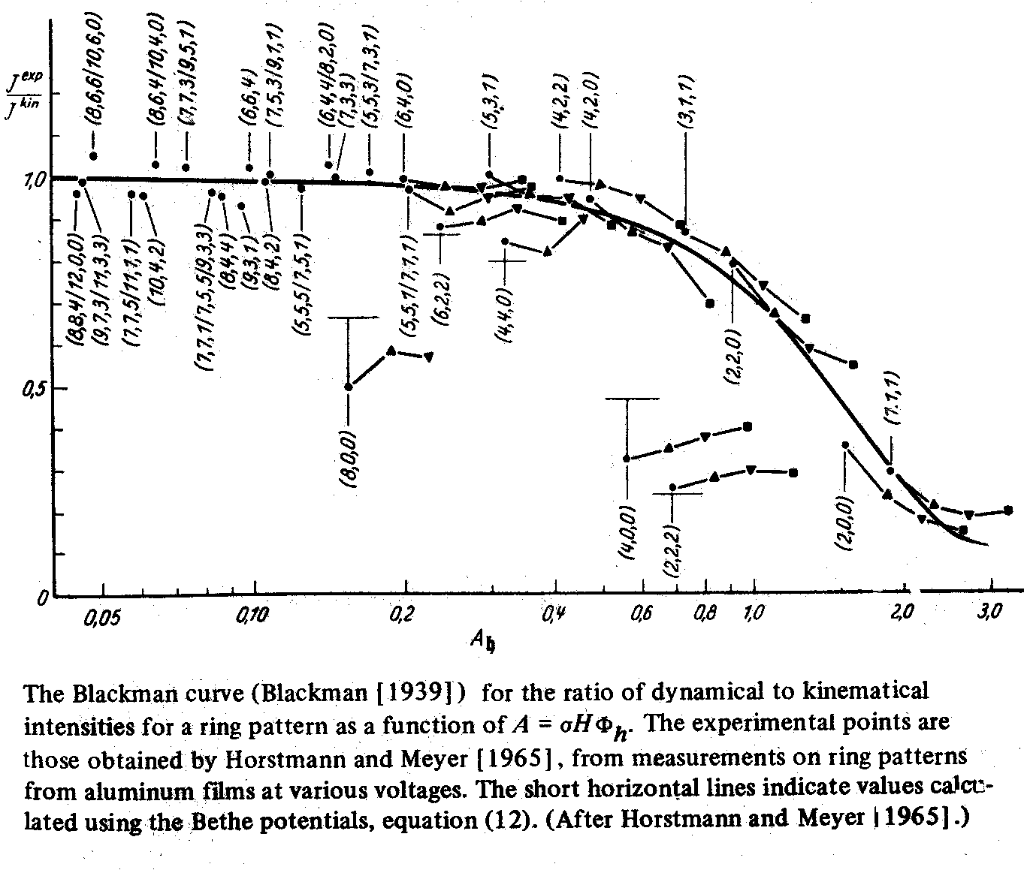
Blackman Form

Slide 32
Blackman+Lorentz
Comparison with full calculation, 24 mRad
Angstroms
Alas, little better than kinematical

Slide 33
Two-Beam Form
I(g) = ∫ | F(g) sin(πts^{eff}_{z})/(πs^{eff}_{z}) |² ds_{z}
s_{z} taken appropriately over the Precession Circuit
s_{z}^{eff} = (s_{z}² + 1/ξ_{g}²)^{1/2}
Do the proper integration over s_{z} (not rocket science)

Slide 34
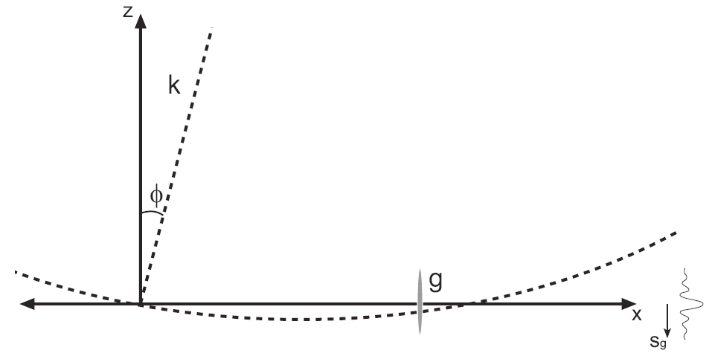
Two-Beam Integration: Ewald Sphere
Small (hkl)
Medium (hkl)
Large (hkl)

Slide 35
2-Beam Integration better
3.2 Å; R=0.02
50 Å; R=0.19
100 Å;R=0.24
200 Å; R=0.44
400 Å*; R=0.62
800 Å; R=0.67

Slide 36
Some numbers
R-factors for 2-beam model
R-factors for kinematical model
See Sinkler, Own and Marks, Ultramic. 107 (2007)

Slide 37
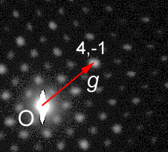
Fully Dynamical: Multislice
“Conventional” multislice (NUMIS code, on cvs)
Integrate over different incident directions 100-1000 tilts
φ = cone semi-angle
  0 – 50 mrad typical
t = thickness
  ~20 – 50 nm typical
  Explore: 4 – 150 nm
g = reflection vector
  |g| = 0.25 – 1 Å⁻¹ are structure-defining
2φ
t

Slide 38
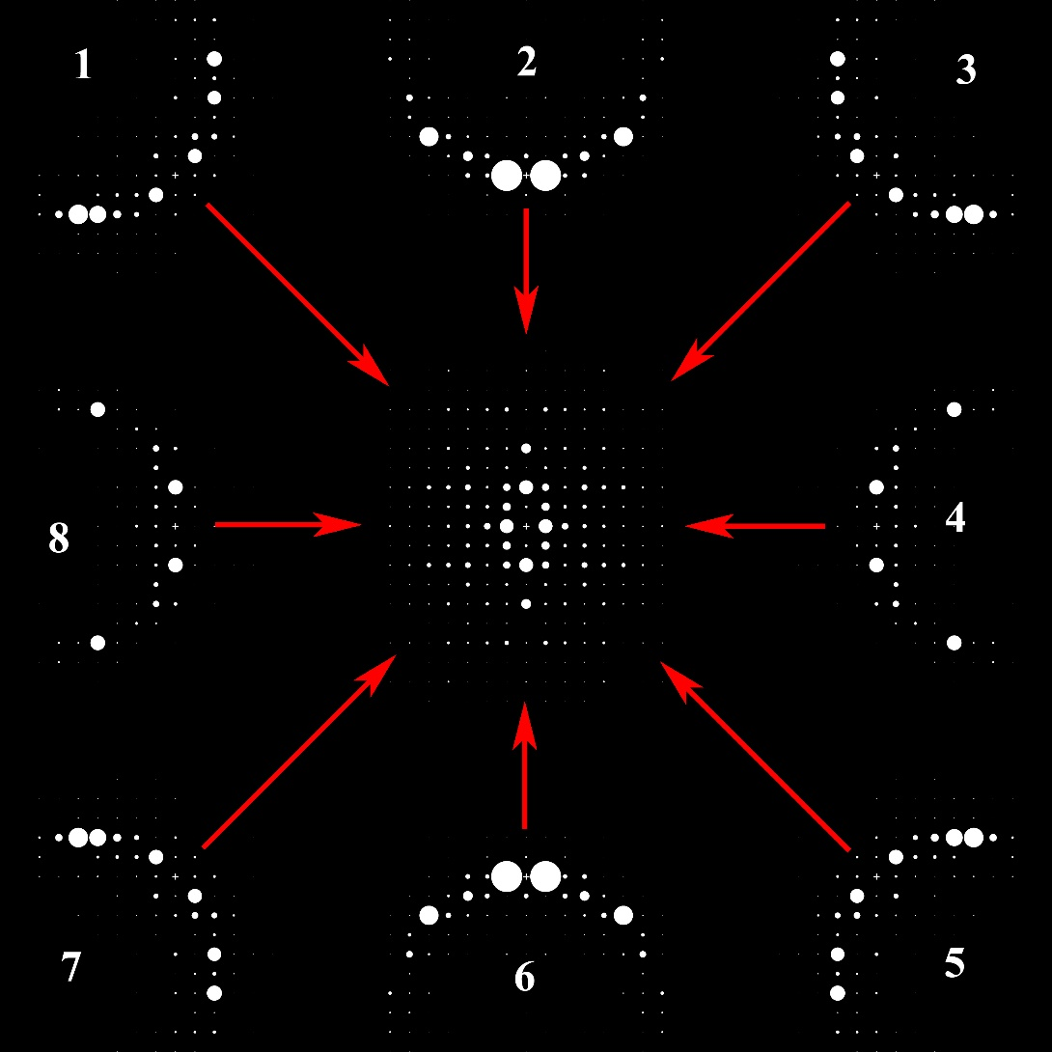
Multislice Simulation
Multislice simulations carried out using 1000 discrete tilts (8 shown) incoherently summed to produce the precession pattern¹
How to treat scattering?
Doyle-Turner (atomistic)
Full charge density string potential -- later
¹ C.S. Own, W. Sinkler, L.D. Marks Acta Cryst A62 434 (2006)

Slide 39
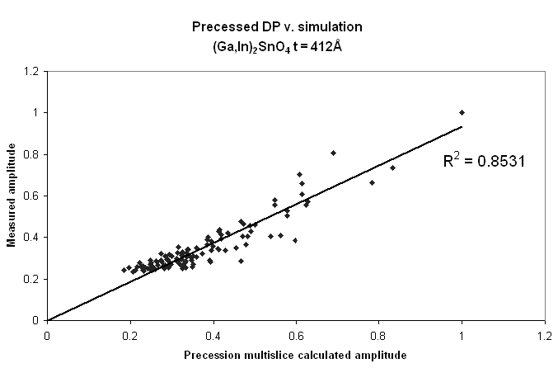
Multislice Simulation: works (of course)
R1 ~10% without refinement of anything

Slide 40
Global error metric: R₁
Broad clear global minimum – atom positions fixed
R-factor = 11.8% (experiment matches simulated known structure)
  Compared to >30% from previous precession studies
Accurate thickness determination:
  Average t ~ 41nm (very thick crystal for studying this material)
(Own, Sinkler, & Marks, in preparation.)

Slide 41






Quantitative Benchmark:
Multislice Simulation
Bragg’s Law
Absolute Error = simulation(t) - kinematical
Error
thickness
g
10mrad
24mrad
0mrad
75mrad
50mrad
Experimental dataset
(Own, Sinkler, & Marks, in preparation.)

Slide 42
Partial Conclusions
Separable corrections fail; doing nothing is normally better
Two-beam correction is not bad (not wonderful)
Only correct model is full dynamical one (alas)
N.B., Other models, e.g. channelling, so far fail badly – the “right” approximation has not been found

Slide 43
Overview
What, if any generalizations can be made?
Role of Precession Angle
  Systematic Row Limit
Importance of integration
  Phase insensitivity
  Important for which reflections are used

Slide 44

Role of Angle: Andalusite
Natural Mineral
  Al₂SiO₅
  Orthorhombic (Pnnm)
    a=7.7942
    b=7.8985
    c=5.559
  32 atoms/unit cell
Sample Prep
  Crushm Disperse on holey carbon film
  Random Orientation
2 C.W.Burnham, Z. Krystall. 115, 269-290, 1961

Slide 45








Measured and Simulated Precession patterns
Experimental
Bragg’s Law Simulation
Multislice
Precession Off
6.5 mrad
13 mrad
18 mrad
24 mrad
32 mrad

Slide 46


Decay of Forbidden Reflections
Decay with increasing precession angle is exponential
  The non-forbidden (002) reflections decays linearly
 | D(001) | D(003)
Experimental | 0.109 R²=0.991 | 0.145 R²=0.999
Simulated (102nm) | 0.112 R²=0.986 | 0.139 R²=0.963
Simulated 28-126 nm | 0.112±0.012 | 0.164±0.015
Rate of decay is relatively invariant of the crystal thickness
Slightly different from Jean-Paul’s & Paul’s – different case

Slide 47


Quasi-systematic row
Precessed
On-Zone
Precession
Systematic Row
Projection of
Incident beam
Forbidden, Allowed by Double Diffraction

Slide 48


Evidence: 2g allowed
Si [110]
Si [112]
Rows of reflections arrowed should be absent (F_{hkl} = 0)
Reflections still present along strong systematic rows
Known breakdown of Blackman model
e⁻
e⁻
μ
μ

Slide 49
Phase and Averaging
For each of the incident condition generate 50 random phase sets {f} and calculate patterns:
Single settings at 0, 12, 24 and 36 mrad (along arbitrary tilt direction).
At fixed semi-angle (36 mrad) average over range of a as follows:
3 settings at intervals of 0.35º
5 settings at intervals of 0.35º
21 settings at intervals of 1º
For each g and thickness compute avg., stdev:
+
+
+
+
+
+
36
0 mrad
12
24
+
+

Slide 50
Phase independence when averaged
single setting
3 settings, 0.35º interval
5 settings, 0.35º interval
21 settings, 1º interval (approaching precession)
Sinkler & Marks, 2009

Slide 51
Why does it work?
If the experimental Patterson Map is similar to the Bragg’s Law Patterson Map, the structure is solvable – Doug Dorset
If the deviations from Bragg’s Law are statistical and “small enough” the structure is solvable – LDM

Slide 52
Why is works - Intensity mapping
Iff I_{obs}(k₁)>I_{obs}(k₂) when F_{kin}(k₁) > F_{kin}(k₂)
  Structure should be invertible (symbolic logic, triplets, flipping…)

Slide 53

Suggested PED flowchart

Slide 54

Preprocess?
“Good” Region
Kinematical (reference)
Precession pattern (experiment)
φ = 24mrad

Slide 55
Speculation…
Generate initial structure estimate
  Use 2-beam approximation to invert/correct
  Partial refinement, using 1/2 kpoint Bloch-Wave method (preprint will be on Los Alamos server soon); large residue least-squares code (e.g. dmnf from Port library)
  Final full refinement using 25-100 beam BW (+Bethe terms, e.g. Stadleman + dmnf)

Slide 56

Hypothesis: Thickness ranges
(not so easy)

Slide 57
Summary
PED is
  Approximately Invertable
  Pseudo Bragg’s Law
  Approximately 2-beam, but not great
  Properly Explained by Dynamical Theory
PED is not
  Pseudo-Kinematical (this is different!)
  Fully Understood by Dummies, yet

Slide 58
Questions ?

